Slide 1
CM2601
OOAD Lecture 03
Use Case Descriptions
CM2601
OOAD Lecture 03
Content created by Guhanathan Poravi

Slide 2
Agenda
Learn how to write use case descriptions

Slide 3
Learning Objectives
Demonstrate evidence of the knowledge set and skill set required by the systems analyst
Specify business processes and business rules
Produce the specification of a computer system

Slide 4
Sample Use Case Description
The next slide shows a common template used to structure use case descriptions
It is simpler to use a prose (narrative) description of a use case
The “typical course of events” script is especially useful

Slide 5
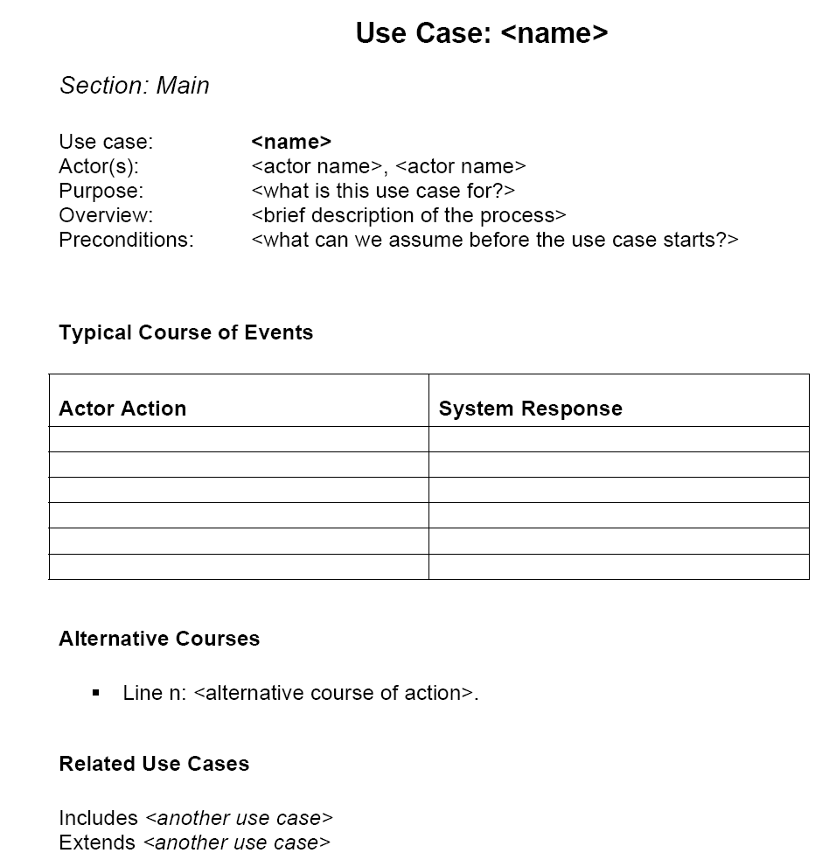

Slide 6
How to fill in the sections of the Use Case Description
Use Case: <name>
Section: Main
Use case: <name>
Actor(s): <actor name>, <actor name>
Purpose: <what is this use case for?>
Overview: <brief description of the process>
Preconditions: <what can we assume before the use case starts?>
Postconditions: <how do we know something happened?>
Typical Course of Events
Alternative Courses
Related Use Cases

Slide 7
Use Case: <name>
The name should be identical to the name of the use case on the diagram

Slide 8
Section: Main
Usual to have just one section, the main one, that describes the typical course of events and the alternatives
This might change if you have several sequences of events that are all as equally valid as the main course of events
In this case you might have several named sections, each with its own typical course of events and alternative courses

Slide 9
Actor(s): <actor name>
The name should be identical to one of the actor names on the use case diagram
If you have more than one actor, make sure that they all do some-role playing the typical course of events

Slide 10
Purpose:
Simply: what is this use case for?
One sentence, 35 words or less

Slide 11
Overview:
Provide a brief description of the process
You should capture what starts the process (the trigger), what happens (the action) and how the process finishes (the result)
Use the following template:
This Use Case begins when …
This Use Case does …
This Use Case concludes (or ends) when …

Slide 12
Preconditions:
What can we assume about the system state before the use case starts?
Examples might be:
The user has been authenticated
The customer has chosen a product
The customer has registered with the system
If there aren’t any, write “Nil” or “None” (but preconditions are helpful, so use them)

Slide 13
Postconditions:
The outcome of a use case
Usually write what happens after a successful conclusion of the use case or what is true about the system state at the conclusion of a use case
Examples:
User is logged in
The customer is sent his/her registration details
Given that the point of a use case is to “yield an observable result of value to an actor”, then there must be at least one postcondition

Slide 14
What to write as action steps (Cockburn, 2000)
What is an action step?
Text placed in any one of the boxes of the typical course of events
Some examples:
"User enters name and address."
"At any time, user can request the money back."
"The system verifies that the name and account are current."
"The system updates the customer’s balance to reflect the charge."

Slide 15
Cockburn’s Guideline#1 (Cockburn, 2000)
Action steps should use simple grammar
Subject ... verb... direct object... prepositional phrase
Example:
The system ... deducts ... the amount ... from the account balance

Slide 16
Helpful hints
Number each action step
Make sure the action steps for your system stay on the RHS
If an actor is named at the top of an elaboration (use case description), make sure that it does something on the LHS

Slide 17
A not so good example

Slide 18
What’s wrong?
Action steps are not numbered
Not much happens, so why is this important enough to be a use case
How does the system really respond?
No alternate course of events, so nothing can go wrong (very unlikely)?
What happens if the userID is wrong?
Or the password?
What about a web server failure (assuming that this system is web-based)?

Slide 19
A(nother) not so good example (Cockburn, 2000)

Slide 20
What’s wrong with this?
Why does the system start the use case?
Action steps too fine-grained
Contains design information
“User clicks OK”
What we meant to say was:
1. User enters name and address.
2. System presents user’s profile.

Slide 21
Branching in the typical course of events
If the user has more than $10000 in his/her account, the system presents an investment option
Else…
We could also say “IF Account balance >= $10000, THEN go to Step 7

Slide 22
Repeated Action(s)
Method 1
Method 2
Actor Action | System Response
1.Customer enters item name | 2.System presents item
3.Customer selects item | 4. System adds item to shopping cart
5. Repeat steps 1-4 until Customer indicates s/he is done
Actor Action | System Response
Repeat
1. Actions go here | 2.And here too
Until <some condition is true>

Slide 23
How to deal with «include»
How do we model including one use case into another in a text-based model?
Easy on a diagram
Perhaps more cumbersome (but still necessary) in a use case description
If a base use-case includes another use-case, add a reference as an action step
Actor Action | System Response
1.The Customer performs the Authenticate User use case | 2.Presents options
3.Chooses option | 4.Etc.
We could also write “<include: Authenticate User>” as the action step”

Slide 24
How to deal with «extend»
Use “Extension Point:<name of extension point/extending use case>” in the action step
The extending use-case includes conditions under which the extension is being committed
Actor Action | System Response
1.The Customer chooses to pay his/her account | 2.Presents options
3.Chooses option Extension Point: Pay by Direct Debit | 4.Etc.

Slide 25
Alternative flow of events
The typical course of events shows the most common (successful) process
But things don’t always work, so we use the alternative flow of events to model
Failures
Errors
Rare behaviour

Slide 26
Choices for modelling alternative flows
Add descriptions of variations in the alternative flow section of the use case description, which may reference an additional use case
or
Modify the body of the use case description to show the alternative flow, especially when you want to emphasis the variation, which may reference an additional use case

Slide 27
Related Use Cases:
Includes <the name of a use case that this use case includes (on the use case diagram)>
i.e. the child use case
Extensions <the name of a use case for which this use case is the base>
i.e. the extension
This should match the typical course of events and the use case diagram

Slide 28
What should not be in a Use Case (Quatrani, 2005)
As implementation details therefore write:
“The student information is saved” and NOT:
“The student information is written to a relational database”

Slide 29
Also not…
GUI information (because that is design, not analysis), so write:
“The student selects a course” and NOT:
“The student presses the Select button to choose a course”

Slide 30
And Never write how….
Internal processing unrelated to a stakeholder request (e.g., how a student number is generated)
Non-functional requirements (e.g., system will be available 24/7) are implemented

Slide 31
Summary
Some useful advice for creating good use cases descriptions
Common pitfalls in writing use cases explained
Guidance on what must be included in a use case description

Slide 32
References
Cockburn, A. (2000) Writing Effective Use Cases. Pre-publication draft.
Constantine, L.L. (1997) The Case for Essential Use Cases. Object Magazine, May 1997, New York, NY: SIGS Publications.
OMG (2007). OMG Unified Modeling Language Superstructure, V2.1.2. Needham, MA: Object Management Group, Inc.
Quatrani, T. (2005) Writing Good Use Cases. Presentation: IBM Software Group
Wirfs-Brock, R. and Schwartz, J. (2001) The Art of Writing Use Cases. Presentation: Wirfs-Brock and Associates.

